Slide 1


Dipartimento di Elettronica, Informazione e Bioingegneria
2025
Unikernel
Milan, 29/08/2025

Slide 2
Unikernel
Unikernel
Analysis of the possibility to map applications and small OS on virtual machine ready for migration/consolidation on edge nodes, when real-time constraints need to be taken into account

Slide 3
Simone Calzolaro
MSc Student
CONTACTS
simone.calzolaro@mail.polimi.it
https://www.deib.polimi.it/eng/home-page

Slide 4
Unikernel
Simone Calzolaro 260121
V1.0
29.08.2025

Slide 5
Introduction
Overview of the main scenarios and related problems

Slide 6
Notes - FAQ
Language: English
Other: include in a zip all the sources of information considered plus the ppt
For each student of the group –at least- 40/50 slides (better more)
Provide general introduction & background, math foundation (if any), standards, techologies, market analysis and current implementation, conclusion with pros 6 cons
Send you candidate work to prof. Fornaciari, receive feedback, provide last version + presentation in one of the designated slots (typ Monday or Friday afternoon)

Slide 7
Cyber-Physical Systems scenario
Virtualization technology consolidates multiple systems as virtual machines (VMs) into the same platform
It allows for:
Cost reduction
Increased efficiency
Enhanced flexibility
Virtualization was initially not designed to cope with strict timing constraints: in CPS like systems timing requirements are as important as functional correctness

Slide 8
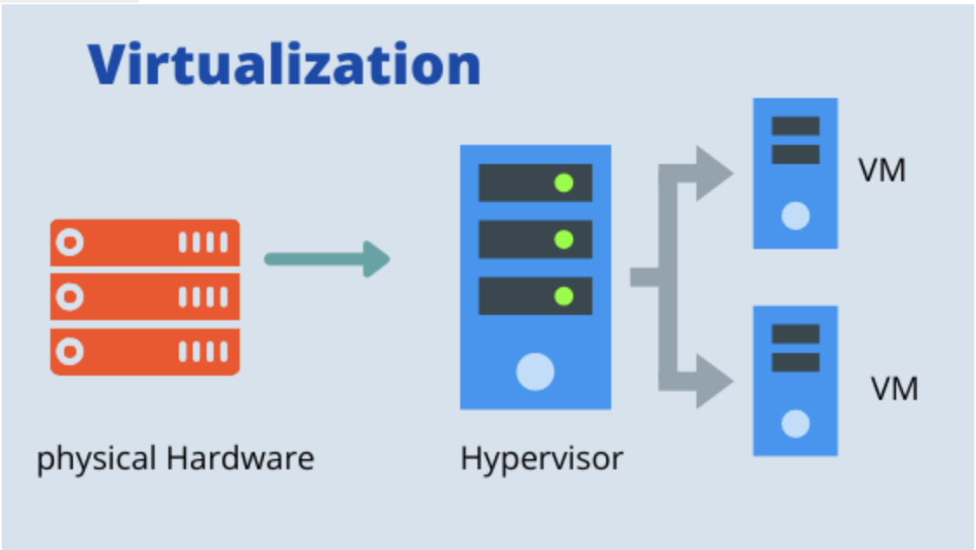
Cyber-Physical Systems scenario
Thus virtualization must be compatible to real-time software stack and satisfy the time constraints by employing hypervisor-level real-time scheduling policies

Slide 9
Cyber-Physical Systems scenario
In data-centers and cloud environments each VM is expected to to host a general purpose operating systems to ease the effort of porting legacy software
Legacy software has a lot of inherent libraries and functionalities
… it can be overkilled in some use cases ☹ …
In fact, most CPS applications are functionally dedicated single purposed, thus not dependent on additional functionalities

Slide 10

Cyber-Physical Systems scenario
Due to the encapsulation of superfluous libraries and the execution of non-essential processes, that are not related to the task of interest, deploying real-time tasks of CPS on a general purpose OS arises various issues:
Resources efficiency
Timing predictability

Slide 11
Embedded Systems scenario
In the era of Big Data, more and more applications of smart devices are computing-intensive
Strong demand for task offloading to cloud data centers
However this gives rise to network delay and privacy data leak issues

Slide 12
Embedded Systems scenario
Edge computing can effectively solve:
Latency
Bandwidth occupation
Data privacy problems
However the deployment of applications are also limited by hardware resources
With the fast development of Internet of Things more and more smart devices are connected to the Internet

Slide 13
Embedded Systems scenario
These devices inevitably produce large amounts of data
Moreover 5G technology can increase network bandwidth and reduce the latency of data transmission
So we face the storage and computing pressure for big data and the geographical limitation of a cloud center
In addition many latency-sensitive applications need milliseconds or even microseconds response time

Slide 14
What is a Unikernel?
Description and definition of the technology, main aspects, architecture and use cases

Slide 15

Basics of Unikernel
Unikernel are sealed, single-purposed virtual machines (VMs) images that can be constructed using the concept of library operating system (LibOS)
Unikernel instance is intended to run a single application, hence it include only a minimal amount of system software code required to execute that application

Slide 16
Basics of Unikernel
This leads to a significant reduction in:
Memory/Disk footprint
Boot time
Attack surface
When compared to traditional virtual machines
LibOS’s allow forn the tailoring of an OS code base to the particular needs of a given task
Only those parts of the OS API are included in the VM image

Slide 17
Basics of Unikernel
Unikernels are characterized by a minimal VM image size which highly increase their security properties
Due to the minimal attack surface for malicious code injection
This also translates to a substantial reduction of overall system’s resource usage
Moreover, Unikernels can be instantiated and become fully functional within only a few milliseconds

Slide 18
Basics of Unikernel
It has further been shown that unikernels are more efficient and safer than modern container technologies
Unikernels have several advantages:
High-security
High start-up speed
High simplicity
It has attracted the researcher’s interest in the field of virtualization
Unikernel is the state-of-the-art virtualization technology

Slide 19
Definition and Characteristics of Unikernel
Unikernel is a specialized, single-address space image constructed by library operating systems (LibOSs)
Unikernel’s essence is a kind of image file with special purpose
In order to support the execution of programs, developer select the smallest set of class libraries from a module stack, together with application code and configuration files
All built into a dedicated image file
So Unikernels have a smaller code base and only run the components that are required for the specific application
Resulting in a smaller overall footprint

Slide 20
Definition and Characteristics of Unikernel
Unikernels improve performance by removing unnecessary components from applications
Unikernel is a single-purpose appliance that is specialized at compile time into a stand-alone kernel and is protected from modification after deployment
Individual applications can be isolated in Unikernels, reducing the risk of cross-application interference
They are self-contained and do not require a separate runtime environment

Slide 21
Definition and Characteristics of Unikernel
So they can be deployed quickly and easily
However, because of their limited runtime environment, unikernels are more vulnerable to security threats
Due to the limited runtime environment and lack of standard tools, debugging unikernel can be difficult
They also increase security by reducing the attack surface

Slide 22
Definition and Characteristics of Unikernel
Unikernels may have a distinct set of vulnerabilities
An attacker who successfully penetrates one may be unable to threaten others
Unikernel can run directly on such hypervisors such as:
Xen
Kernel-based Virtual Machine (KVM)
Hardware without operating system

Slide 23
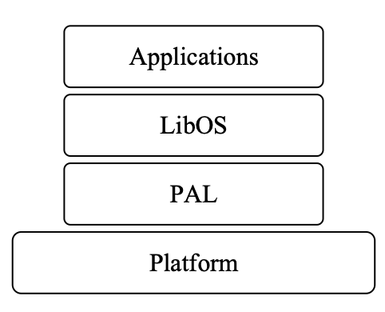
Architecture of Unikernel
Unikernel is divided into 3 layers over hardware platform or hypervisor:
Application layer
LibOS layer
Platform Adaptation Layer (PAL)

Slide 24
Architecture of Unikernel
User applications run at the application layer
These application programs are generally:
Single function
Small size
High-performance
Which are convenient for fast deployment
Their characteristics conform to microservice application
LibOS is at the middle layer

Slide 25
Architecture of Unikernel
It is specifically divided into a kernel base and functional system
LibOS complete the basic functions of an OS:
Task scheduling
Thread management
Platform Adaptation Layer are the minimum core components to support application execution

Slide 26
Architecture of Unikernel
PAL includes:
An adaptation layer with host environments running on a bare machine
A virtual environment running on a hypervisor
PAL is used mainly for LibOS application migration and need not change LibOS or application code when hardware is updated

Slide 27
Use cases of Unikernel
Unikernel was originally intended for cloud computing
However, its small footprint and flexibility make it ideal for other applications:
Real-time applications: unikernels are lightweight and efficient, so they can handle real-time applications
Edge-gateways: acting as a middleman between devices and the cloud
Autonomous vehicles: unikernels can be used in self-driving cars to provide real-time data processing and decision making capabilities
Cloud-Native Edge computing
Network functions

Slide 28
The choice of Unikernels
The choice of unikernels are driven by a variety of factors:
Resource efficiency: unikernels are compact and efficient, making them excellent for edge computing applications where hardware resources are restricted
Security: because of their small size unikernels have a lower attack surface, resulting in a higher degree of protection
Isolation: provide good isolation between diverse workloads, they are ideal for instances where numerous tenants share the same hardware
Simplified management: unikernel facilitate the management and deployment of applications at the edge by minimizing the overhead of standards OSs

Slide 29
Unikernel-Based Real-Time Virtualization under Deferrable Servers
Analysis and Realization

Slide 30
Introduction
Real-time virtualization optimized the hardware utilization by consolidating multiple systems into the same platform
While satisfying the timing constraints of their real-time tasks
We consider here virtualization based on Unikernels
Each Unikernel is a guest operating system in the virtualization and hosts a single real-time task
We consider deferrable server in the virtualization platform to schedule the unikernel-based guest operating systems and analyze the worst-case response time of a sporadic real-time task under such a virtualization architecture

Slide 31
Introduction
Virtualization must be compatible to real-time software stack and satisfy the time constraints by employing hypervisor-level scheduling policies
The Xen hypervisor, periodic server-based approach have been widely used
Especially deferrable servers
Each virtual CPU (vCPU) is treated as one deferrable server assigned with an execution budget and a replenishment

Slide 32
Introduction
The scheduling decision involves 2 levels:
The hypervisor scheduler
The scheduler within the VMs
In a hierarchical manner
To account for the interplay of servers and tasks, the applicability of such server based approaches is based on the tightness of corresponding worst-case response time analyses

Slide 33
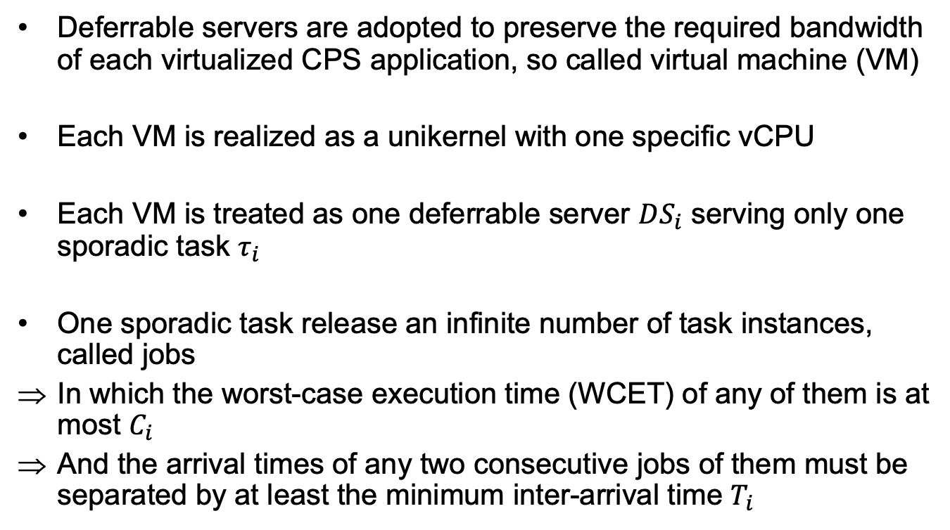
Deferrable Server and Task model
Deferrable servers are adopted to preserve the required bandwidth of each virtualized CPS application, so called virtual machine (VM)
Each VM is realized as a unikernel with one specific vCPU
Each VM is treated as one deferrable server $DS_{i}$ serving only one sporadic task $τ_{i}$
One sporadic task release an infinite number of task instances, called jobs
In which the worst-case execution time (WCET) of any of them is at most $C_{i}$
And the arrival times of any two consecutive jobs of them must be separated by at least the minimum inter-arrival time $T_{i}$

Slide 34
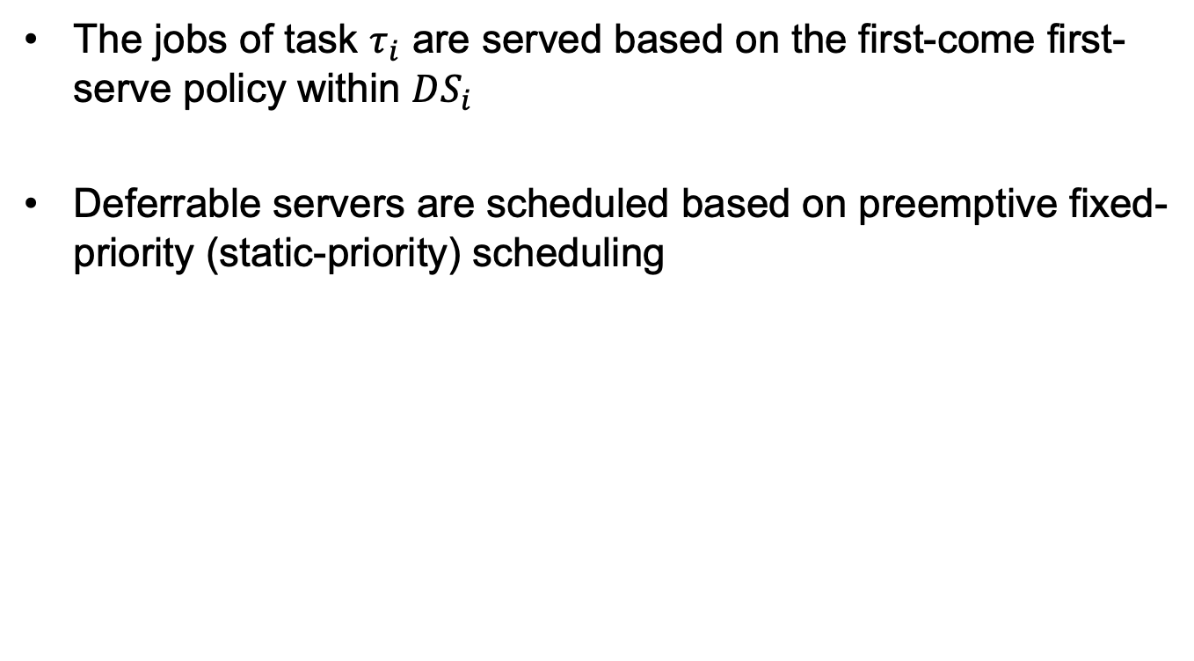
Deferrable Server and Task model
The jobs of task $τ_{i}$ are served based on the first-come first-serve policy within $DS_{i}$
Deferrable servers are scheduled based on preemptive fixed-priority (static-priority) scheduling

Slide 35
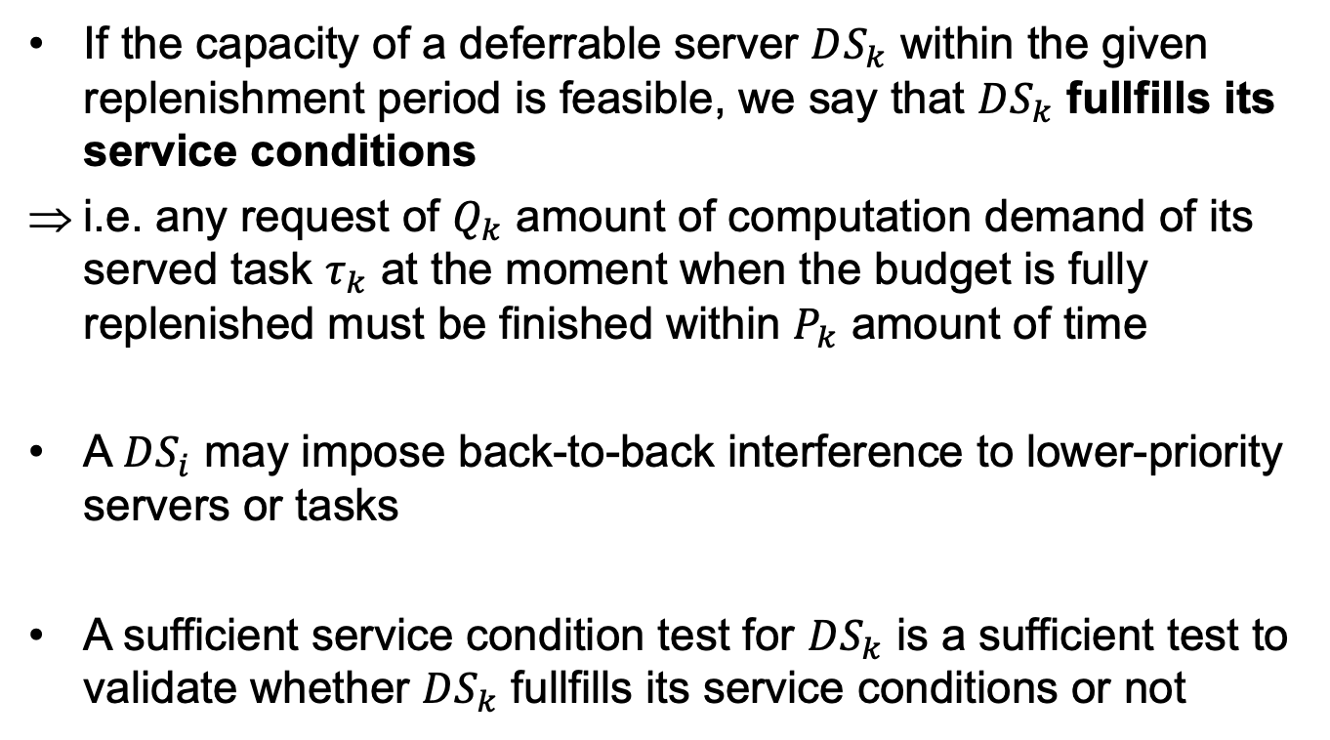
Service Condition and Execution Scenarios of Deferrable servers
If the capacity of a deferrable server $DS_{k}$ within the given replenishment period is feasible, we say that $DS_{k}$ fullfills its service conditions
i.e. any request of $Q_{k}$ amount of computation demand of its served task $τ_{k}$ at the moment when the budget is fully replenished must be finished within $P_{k}$ amount of time
A $DS_{i}$ may impose back-to-back interference to lower-priority servers or tasks
A sufficient service condition test for $DS_{k}$ is a sufficient test to validate whether $DS_{k}$ fullfills its service conditions or not

Slide 36
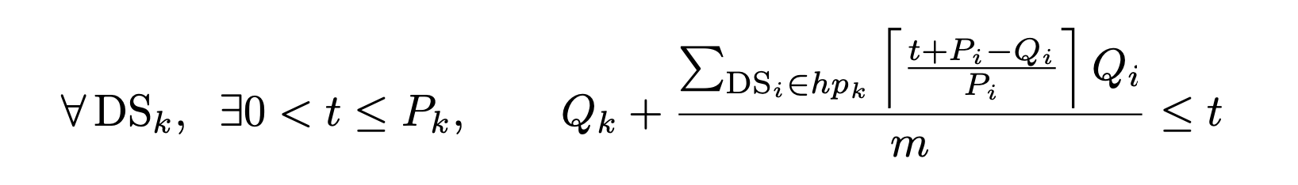
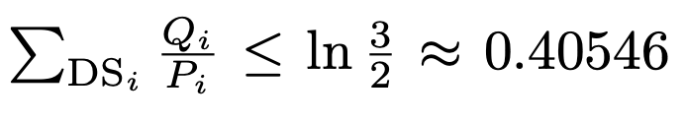
Service Condition and Execution Scenarios of Deferrable servers
Sufficient service condition for uniprocessor preemptive fixed-priority scheduling of systems composed of only fixed-priority deferrable servers:
The equation ensures that the condition stated in the previous equation hold

Slide 37
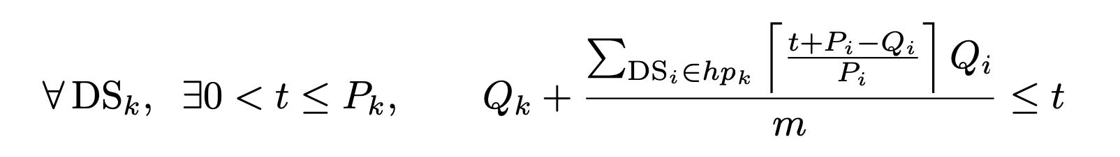
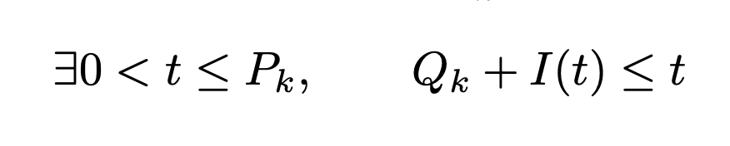
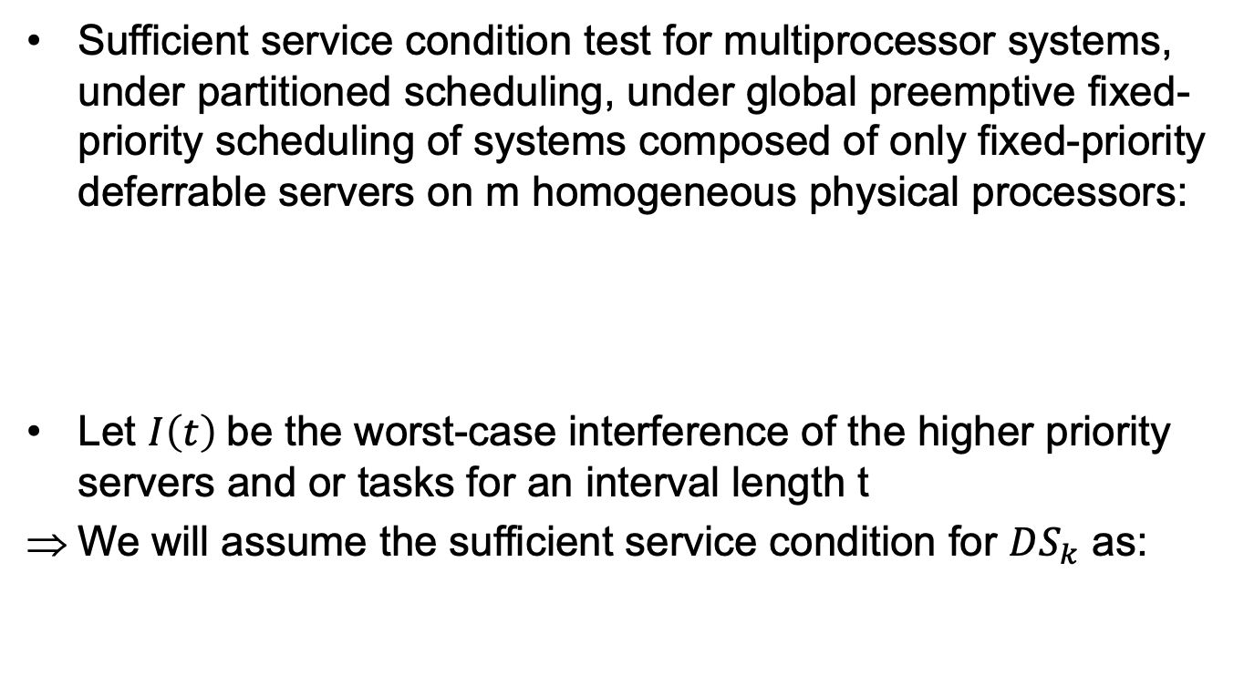
Service Condition and Execution Scenarios of Deferrable servers
Sufficient service condition test for multiprocessor systems, under partitioned scheduling, under global preemptive fixed-priority scheduling of systems composed of only fixed-priority deferrable servers on m homogeneous physical processors:
Let $I\left(t\right)$be the worst-case interference of the higher priority servers and or tasks for an interval length t
We will assume the sufficient service condition for $DS_{k}$ as:

Slide 38
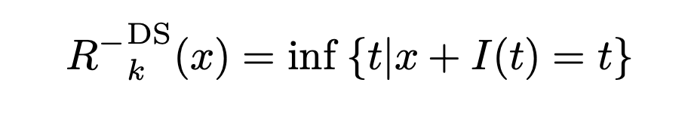
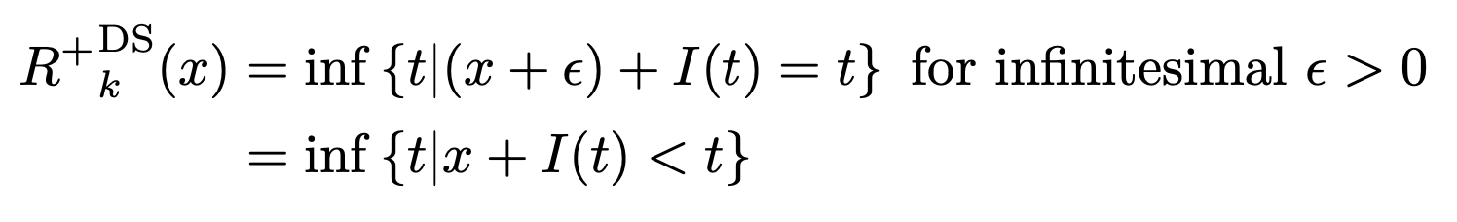
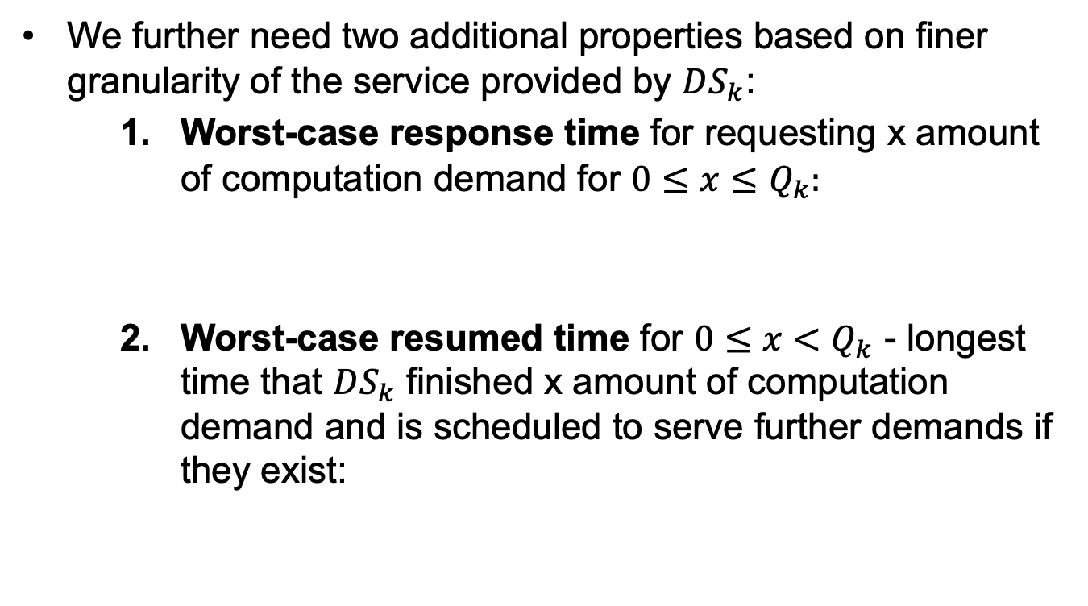
Service Condition and Execution Scenarios of Deferrable servers
We further need two additional properties based on finer granularity of the service provided by $DS_{k}$:
Worst-case response time for requesting x amount of computation demand for $0≤x≤Q_{k}:$
Worst-case resumed time for $0≤x<Q_{k}$ - longest time that $DS_{k}$ finished x amount of computation demand and is scheduled to serve further demands if they exist:

Slide 39
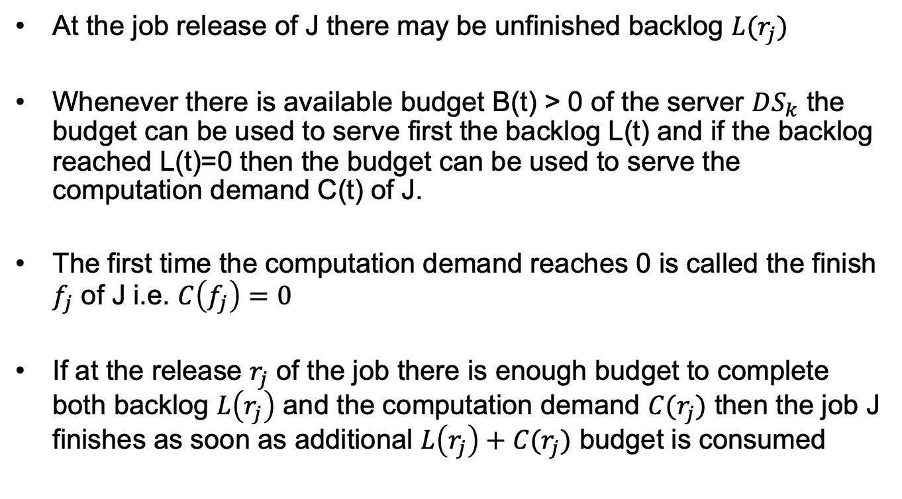
Service Condition and Execution Scenarios of Deferrable servers
At the job release of J there may be unfinished backlog $L(r_{j})$
Whenever there is available budget B(t) > 0 of the server $DS_{k}$ the budget can be used to serve first the backlog L(t) and if the backlog reached L(t)=0 then the budget can be used to serve the computation demand C(t) of J.
The first time the computation demand reaches 0 is called the finish $f_{j}$ of J i.e. $C\left(f_{j}\right)=0$
If at the release $r_{j}$ of the job there is enough budget to complete both backlog $L\left(r_{j}\right)$ and the computation demand $C(r_{j})$ then the job J finishes as soon as additional $L\left(r_{j}\right)+C(r_{j})$ budget is consumed

Slide 40
Service Condition and Execution Scenarios of Deferrable servers

Slide 41
Title of the slide
Text of the slide
At present it is not clear how
Implementation of the algorithms is envisage only for
1060
1061 A/B
Implementation will be first done for 1060 devices
No significant constraints w.r.t. code size, data size, processing time
Example of table | Count
1059 | 11529
1059 | 6359
1059A/B | 50457
First | 144036
Second | 212443
Other | 11780
Total | 436604

